Slide 1

Object-Oriented Programming Discussion, Lecture, & Lab Eric Pogue
Agenda for Friday, September 27th from 2 to 2:50pm CST:
Friendly Conversation Topic – Uline Recruiting Notes & Comments
Assignment from Last Class
Q&A session for Graphical User Interfaces (GUI) in Java
GUI Application Programming before OOP
Assignment for Next Class
Lab
Discussion & Questions welcome at any time… please be present with no phones or email during our time together

Slide 2
Uline Recruiting Notes & Comments
Notes:
https://www.uline.jobs/JobSearchResults?culture=en&department=information%20technology&sort=Department-asc
Starting at 3pm in 106A

Slide 3
Assignment
Complete Activities List items through item 5 and be prepared to discuss them at the start of our next class.

Slide 4
Q&A: Graphical User Interfaces (GUI) in Java
Summarize Java Graphical User Interface Development
Position Java GUI development
Explain Heavyweight components
Explain Lightweight components
Examine the paint and paintComponent methods
Explain Layout Managers
Review Class extension
Introduce Interface implementation
Introduce Event Handling
Examine an implementation of ActionListener

Slide 5
GUI Application Programming before Object-Oriented Programming
Notes:
https://www.uline.jobs/JobSearchResults?culture=en&department=information%20technology&sort=Department-asc
Starting at 3pm in 106A

Slide 6
Assignment
Complete Activities List items through item 6 and be prepared to discuss them at the start of our next class. Plus have a solid start on item 7.
Prepare to discuss one GUI topic in our next class.

Slide 7
Topics
Summarize Java Graphical User Interface Development
Position Java GUI development
Explain Heavyweight components
Explain Lightweight components
Examine the paint and paintComponent methods
Explain Layout Managers
Review Class extension
Introduce Interface implementation
Introduce Event Handling
Examine an implementation of ActionListener

Slide 8
Lab
As A Scrum Team:
Assign “Graphical User Interfaces (GUI)” topic to each person to discuss next class
FaceDraw, FaceDraw, FaceDraw
Team report out by new Scrum Master at 2:48
Team Report Out Guidelines
Scrum Master will stand up, give your name, your team name, and briefly answer the following questions:
What did you accomplish since the last meeting? And what will you be working on until the next meeting?
Is the team committed to completing assignments? All/Most/Some
What is getting in your way or keeping you from completing the assignments?

Slide 9
End of Session

Slide 10
Self-Improvement and Working with Teams … Or Uline
Notes:
https://www.uline.jobs/JobSearchResults?culture=en&department=information%20technology&sort=Department-asc
Starting at 3pm in 106A

Slide 11
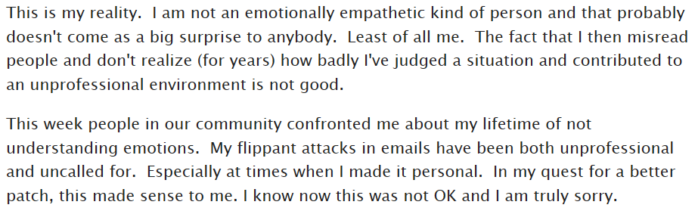
Who is the Author

Slide 12

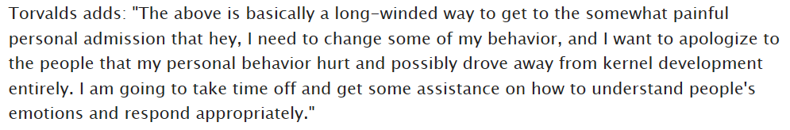
Answer

Slide 13
Suggested Reading: Dale Carnegie

Slide 14
Notes:
Optimism & Good-natured Humor

